Slide 1
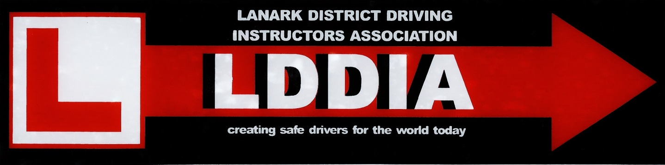
Client Centred Learning (CCL)
A presentation by Graham May DSA ADI
Notes:
Good Evening Ladies and Gentlemen. I have put together a short presentation about what is sometimes called ‘coaching’ but more commonly referred to nowadays as ‘Client Centred Learning’. Feel free to ask any questions during the presentation or afterwards. I’m in no way an expert in this field, but have recently completed a BTEC Level 4 in Coaching for Driver Development which I undertook to find out what ‘coaching’ was all about. The slides assume you know nothing about coaching or CCL, so they function as an introduction for a complete beginner.

Slide 2

Introduction
This presentation will discuss :
The Traditional Instruction Method
Some Hard Facts about Young Drivers
The Hermes Project and the GDE Matrix
Jordan and the Lanark Young Team
What actually is Client Centred Learning?
Why do we need to take notice of CCL?
Quick Tips for making lessons more Client Centred immediately

Slide 3

You might be doing a lot of this already but not appreciate it, and ….....
At this stage, though, it’s important to ….....

Slide 4
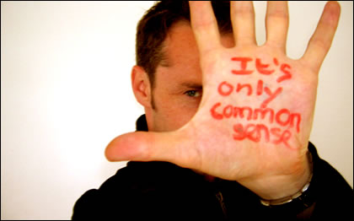
Well, most of it, but traditional instructing and ADI training haven’t always been based on common sense…..

Slide 5
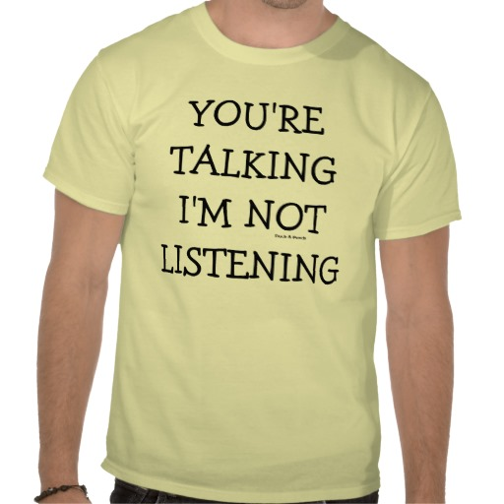
Traditional Instruction
ADI takes on all the responsibility for teaching what is needed to pass the Driving Test.
ADI decides what, how, where and in what order subjects are to be taught.
ADI decides whether the pupil is good enough to move on to something new, and ultimately when the pupil is test-ready.
Learning is instructor led – the ‘pupil’ has a passive role, with few choices or chances to express themselves.
It’s a ‘hierarchical’ relationship (like a parent to child – do what I say!)
As such it’s a rigid, ‘one size fits all’ approach to learning
The ultimate aim is to achieve ‘test standard’. Risky behaviour and personality traits that may surface and affect post-test driving are stifled, hidden, and therefore never challenged.

Slide 6
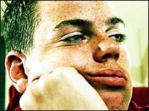
Who knows what they really think, feel or believe??….
“I know driving fast is a wee bit daft, but I loved it and my friends thought it was a great laugh!!”
“Mum and dad don’t drive like this, but I’d better play the game for now if I want to pass my test”
“I can’t wait to pass my test and get rid of this muppet!! Then I’ll finally be in charge and can do what I want at last”
“I’m just not getting this, I wish he could have explained it differently”
“He keeps telling me to take my time, but that guy behind looks really annoyed with me for holding him up“
“I thought I did that really well – I felt crap when he told me it was rubbish! I’m not enjoying this”
“It’s ok to use your phone whilst driving – my brother does and he’s never crashed!”

Slide 7



Traditional Instruction - fit for purpose?
Great for structure
Gets them through the test
Suits the instructor
BUT argued that the client’s underlying beliefs, values and motivations are not challenged or discussed .
So after the test, Safe Driving for Life…..????

Slide 8

Some Hard Facts about Young Drivers
Road crashes are the single biggest killer of young people in the UK
170 road deaths in Scotland last year – that’s more than 3 a week. 70% are on rural roads.
1,959 seriously injured in Scotland last year – that’s about 38 per week.
17 – 20 yr-olds are involved in 25% of fatal or serious road crashes despite making up only 12% of driver population. An 18-yr-old driver is more than three times as likely to be involved in a crash as a 48 yr-old
Young male drivers are 7 times more at risk of crashing than all male drivers - but between the hours of 2am and 5am their risk is 17 times higher
With two or more passengers, the fatal crash risk for 17-19 year-old drivers is more than five times it is when driving alone
Of young people killed on roads, only one-third of young drivers and one-fifth of young passengers were wearing seat belts ……
But the most shocking of all…
One in five new drivers has a crash within six months of passing their test!!
(not my pupils though, must be someone else’s ……..)

Slide 9

What’s behind the statistics?
This is where the common sense has been letting us down! We all know why! Young drivers always have been and continue to be ...
Susceptible to peer pressure / showing off
Risk takers, especially young males
Inexperienced / over-confident
Feel invincible
Studies show frontal lobe of the brain doesn’t fully mature until mid 20s – the area that helps us to control emotions and impulse
More likely to drive at night
More likely to be surrounded by Alcohol / Drugs
But all drivers are susceptible to emotions – accidents are rarely a lack of driving skill but rather distraction/stress/lack of planning/rush
A Seriously Dangerous Mix
The New Question
Are ADIs giving good enough training?????? Are we just teaching ‘pupils’ to ‘pass the test’ not ‘to really drive’?
This is not going unnoticed by the powers that be….

Slide 10

The GDE Matrix and the HERMES Project
The Goals for Driver Education (GDE) matrix was the culmination of years of research into what makes a good, safe driver. Published by Hatakka, Keskinen, Gregerson and Hernetkoski in 2002
The High Impact approach for Enhancing Road safety through More Effective communication Skills (HERMES) Project was an EU wide project completed in 2007.
HERMES Project recommended incorporating the 2002 ‘Goals for Driver Education’ into driver training across all member states.
HERMES study found coaching is more effective than instructing to implement the GDE Matrix
In the UK, the DSA (the powers that be) were watching….

Slide 11
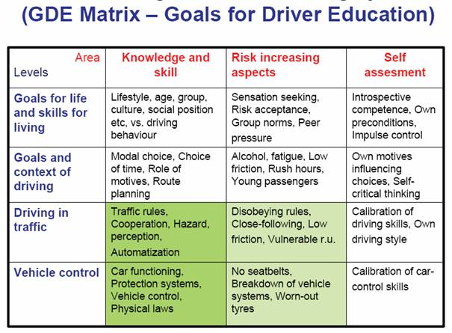
Goals for Driver Education (2002)
Level Four
Level Three
Level Two
Level One
Notes:
Traditionally driver training and testing has focused on car control and traffic law (Level 1 - Vehicle Control and Level 2 - Driving in Traffic), and even then only the knowledge and skills column of those levels. The GDE Matrix goes much further, adding in Level 3 - Goals and Context of Driving (situational issues, such as passengers, alcohol, emotions, tiredness etc) and Level 4 – Goals for Life and skills for Living (personality, attitude to risk etc). The columns of the matrix also detail the risk increasing aspects related to the 4 levels, and the self-assessment skills a driver needs to become self-aware of these risks and do something about them. By only dealing with Levels 1 and 2, traditional driver training has been missing the point.

Slide 12
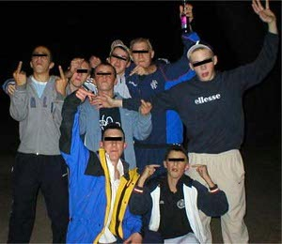
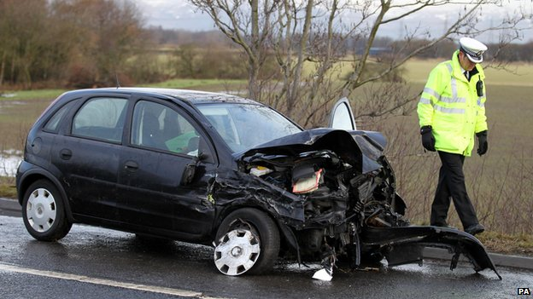
Meet Jordan and the Lanark Young Team (LYT)
Jordan is 18 year old and driving his friends home from a party at 3am in December, a journey he has done many times on lessons with no problems (he even did it on his Test!)
He only had two bottles of beer (as his dad does this and has never had a problem driving).
On the way home, his friends slag him about his ‘granny’ driving, and to show off he speeds up to 75mph on the NSL road.
Jordan has started to love the thrill of fast driving anyway
Unfortunately, Jordan does not slow for a bend in time, skids on ice and hits a tree
Two passengers in the back weren’t wearing seatbelts, and one of them dies.

Slide 13
Was it Jordan’s lack of vehicle control (Level 1 GDE) to blame?
Or his knowledge of the traffic laws (Level 2 GDE)?
Superficially, yes. But he knew the speed limit, ‘’not” to drink and drive, how to use the brake, and had negotiated the very same bend successfully on his Driving Test!
More likely the blame lies in …..
the influence of the passengers – peer pressure (Level 4),
Jordan’s personality – weak to resist teasing, likes thrill of fast driving (Level 4)
lack of concentration - alcohol / late night (Level 3)
Extra weight in car, no seat belts and poorweather conditions (risk increasing Level 1 + 2)
the mistaken belief handed down from his dad that drinking a wee bit then driving was ‘ok’ (Level 4).
Unaware (untrained?) of the risks Jordan was unprepared to combat them.
Traditional Level 1 and 2 ‘knowledge and skill’ instruction ineffective here!
Coaching or client centred learning is thought to allow ADIs a better opportunity to target all the GDE

Slide 14
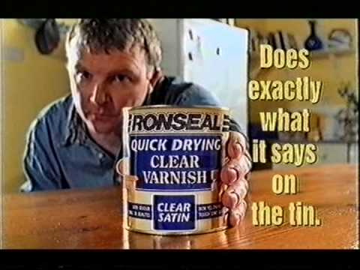
So what actually is Client Centred Learning?
Client centred means the ‘client’ (not ‘pupil’ anymore) is at the centre of the learning process
Lessons based on client’s learning style, not instructor’s teaching style
Based on the key ‘coaching’ skills – rapport / questioning / listening / feedback
Better tool for delivering the self-awareness and self-evaluation skills required by the higher levels of the GDE
Driver trainer’s role is a facilitator of learning rather than that of an expert who must be listened to and obeyed
Using (T)GROW , the client is involved and encouraged straight away to take ownership and responsibility for :
Picking their own topic (may need help in early lessons)
Setting their own goals
Planning their own learning based on their own preferred learning style
Evaluating the pros and cons of their own performance
Deciding on the best solution and way forward to address any issues
(T) opic
G oals
R eality
O ptions
W ay Forward

Slide 15

Learning Styles
Read/Write (books, mind-maps, lists, acronymns)
Aural (talk-throughs, discussions, dicta-phones)
Visual (diagrams, demonstrations, videos, ipad)
Kinaesthetic (give it a go, trial and error)
60% of people are ‘multi-modal’
Questionnaires exist to establish what the preferred learning style is
But just ask! Eg how did you study best at school? Do you read instruction manuals? What flicks your switch when learning?
Listen for clues – ‘I see what you’re saying’ (visual) or ‘I hear you’ (aural)

Slide 16


Key Coaching Skills
Rapport
equal, adult to adult relationship
pupil-led not ADI led
turn around/eye contact
match language/tone/body language to create a comfortable learning environment
Questioning
open questions not closed or leading
client will (hopefully) be more encouraged to tell you how they really think or feel – allowing opportunity to probe further
good questions target feelings, beliefs and thoughts giving you INSIGHT
‘How did that feel?’ not ‘Tell me what was wrong with your speed at that roundabout?’
‘Why are you choosing this speed just now?” not ‘Do you know the speed limit here?’
‘What were you thinking when…?’ not ‘Did you not see that guy coming?’
only if client doesn’t self evaluate do you become more leading / finally closed
BUT remember to ask questions when things are going well too!
Don’t just stop when something goes wrong (eg answer to above could be ‘Cause road is clear, speed limit is 50mph – well done!)
Otherwise client gets wise, demotivated and can clam up!

Slide 17
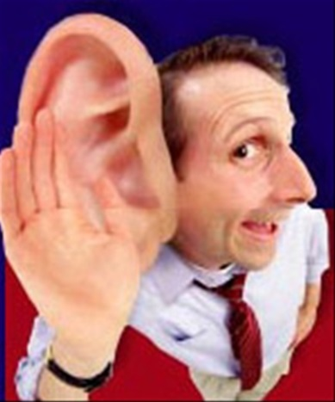
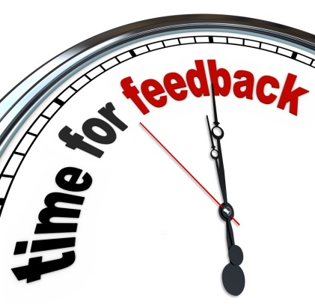
Key Coaching Skills
Listening
actively listen to words and body language
avoid being a ‘serial helper’ – good intentioned but you’ll not always be there!
really listen - avoid interrupting client, don’t rush them to answer (count to ten in head)
don’t think about next thing whilst client is answering
client does most of the talking (and the thinking)
Feedback
be positive, friendly and constructive
avoid the ‘Praise Sandwich’ (aka the ‘Sh*t Sandwich’)
best is self-elicited (comes from the client themselves)
praise the good, get them to tell you the bad (win/win as your not the deliverer of the bad news!) and….
self-reflection by pupil = better self-awareness
use scaling techniques

Slide 18
Benefits of Client Centred Learning
Based on an equal partnership where the aim is ‘safe driving for life’ not just passing the test – responsibility is given to learner from outset
Clients are more engaged and less bored – who like being ‘told’ what to do?
ADI is still an expert if needed, but more a ‘facilitator’ of learning through the questions and self-evaluation skills he promotes – extremely valuable post-test skills because self-aware pupils are more likely to be safe drivers for life.
Client is allowed to ‘be themselves’, so the ADI has a greater insight into their true thoughts and beliefs - and can more effectively challenge any risky behaviour choices.
With this environment, ADIs are better placed to address the higher levels of the GDE by encouraging pupils to think about :
how the context of their journey (GDE Level 3),
their lifestyle choices and their personality (GDE Level 4)
might affect their car control (GDE Level 1) and
the traffic around them (GDE Level 2).
Give a man a fish, he’ll feed himself for a day! Teach him how, he’ll feed himself for a lifetime – the skills of self evaluation can be used forever
If client is more engaged they enjoy it more = more recommendations = happier ADI!!

Slide 19

Why do we need to take notice?
DSA are going for CCL in a big way and implementing this as the next big thing.
The ‘National Standard for Driver and Rider Training’ published in 2011, is heavily focussed on client centred learning rather than traditional instruction.
Current Modernising Driver Training Consultation and the new Standards Check coming in April 2014 are heavily influenced by CCL approaches

Slide 20


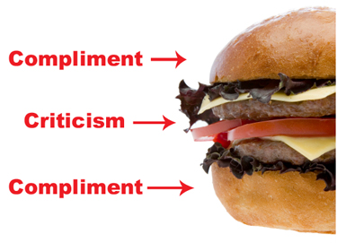
CCL Quick Tips
Focus on the key coaching skills of rapport, open questioning, really listening and self-elicited, positive feedback
Use (T)GROW with your pupils – let them set the objectives!
Try to match the client’s preferred learning style and teach accordingly (Visual, Aural, Read/Write or Kinesthetic)
Avoid the ‘Praise Sandwich’ – it’s negative and they either don’t hear the praise focussing on the criticism or don’t believe the praise thinking you’re just buttering them up – you are!
Better to get the client to feedback on their own performance – be their own critic and you don’t have to deliver the bad news! Target your feedback on areas the client has not noticed.
Use a Scaling technique based on S – E – D – S – S
Scale (student scales their performance from 0 – 10)
Evidence (why have they given themselves this score? – positives too!)
Development (how do they need to improve?)
Support (what help do they want from the ADI to improve?)
Success (how will they know when they have improved?)
Read ‘Can Drivers Really Teach Themselves?” by Ian Edwards (the only UK driving instructor to take part in the HERMES project)
(T) opic
G oals
R eality
O ptions
W ay Forward

Slide 21
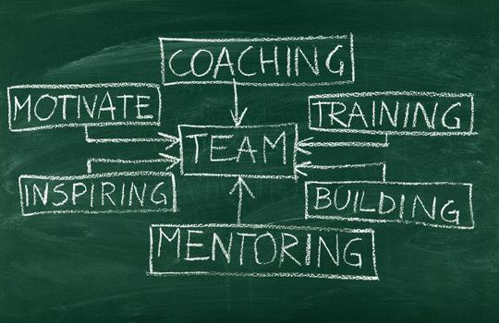
My Conclusions – a changing role….
A modern ADI can’t just be an ‘instructor’ any more (as if that’s all they ‘just’ were traditionally)
Traditional instructing does not work for everyone – either during the learning process or after the test
BUT I’m not going to throw it all away – just modify where required
Traditional training, PSTs and core competencies can create ADIs more focussed on drivers passing the test than safe driving for life
I give pupils (sorry ‘clients’) too little information about alcohol / drugs / speeding / real driving issues
CCL definitely allows me to better engage clients about these real issues
To be the best ADI I can be, and make a difference to road safety, I need to place much greater emphasis on the GDE as a teaching aid.

Slide 22

Thanks for Listening!
Any Questions?

